Slide 1
SRT 211 Final Project
Group 6
Professor Name: Nilay Ganatra
Students: Yau On Li & David Tang
Student ID:yli693, dtang31
Notes:
u

Slide 2

Table of contents
Project Definition + Scope
Project Objectives
Documents + Tools used
Project Description
Website Features
Project Outcomes

Slide 3

Project Definition and Scope
Development of a robust, front-backend flask-based web application
html code in the frontend
Sql Database in the backend
Flask.app used as connector and route director
Virtual environment deployed
HTML used to create the structure of the webpages, allows for user interactions, stores and sent data into flaskapp
Flaskapp receives and handle GET/POST requests from frontend, redirects user to correct url, performs sql queries on the backend database
Database entries updated and relayed back to flaskapp and the frontend.

Slide 4
Project Objectives
1. Displays a responsive webpage
2. Supports user interaction
3. Stores and retrieves data to/from frontend/backend
4. Involves html, css, python and MySQL

Slide 5
Documents submitted
GitHub link: https://github.com/dtang31/SRT-Final-Project (currently set to private)
Static folder
pictures, style.css
Templates
about.html, add_car.html, add_review.html, car_info.html, home.html, review_one.html, view_cars.html
Flaskapp
App.py
SRT 211 Final Project Presentation.pptx – Presentation slides
Project Requirement & System Flow.docx – Preliminary project scope and description
flaskapp_flaskapp_cars.sql – Export file of the cars table
flaskapp_flaskapp_reviews.sql – Export file of the reviews table

Slide 6
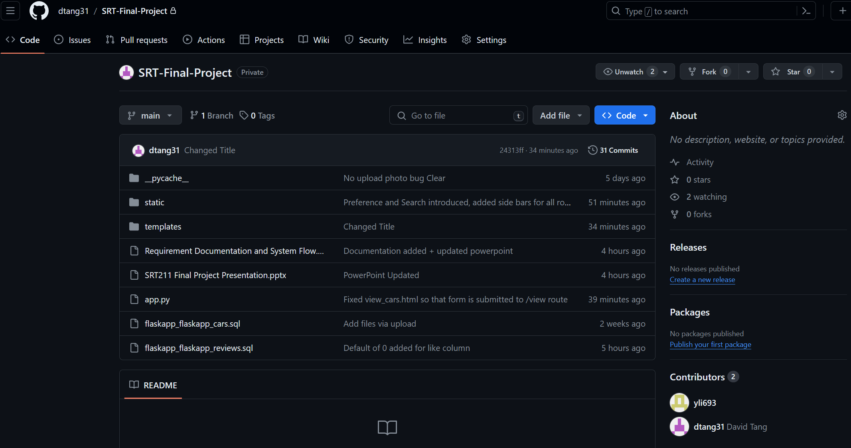
Github Repo
https://github.com/dtang31/SRT-Final-Project

Slide 7
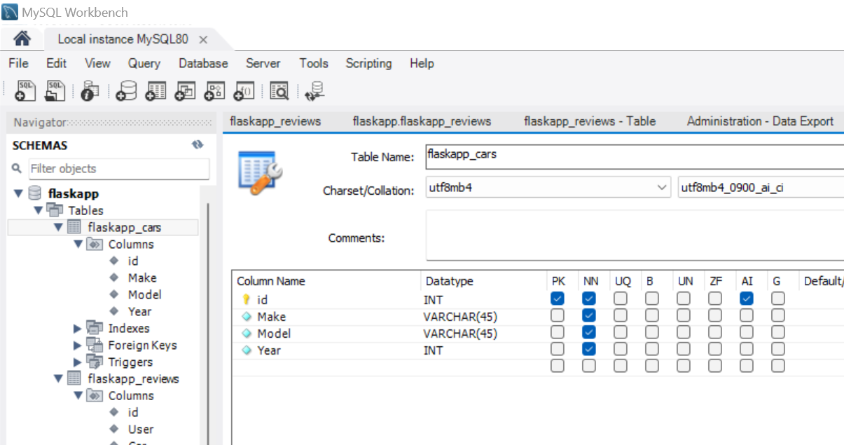
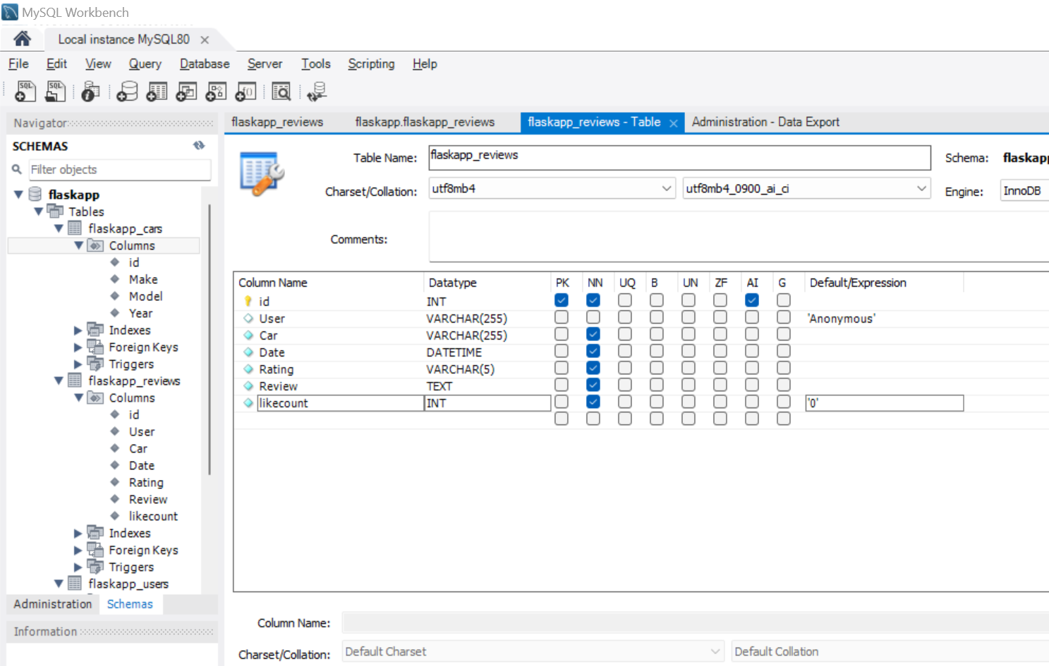
Database/DATA dictionary design
MySQL workbench used to store form data submitted form the frontend
Created flaskapp schema
Flaskapp_cars: ID (PK), Car Make, Car Model, Year
Flaskapp_reviews: ID (PK), User, Car, Date, Rating, Review, likecount

Slide 8
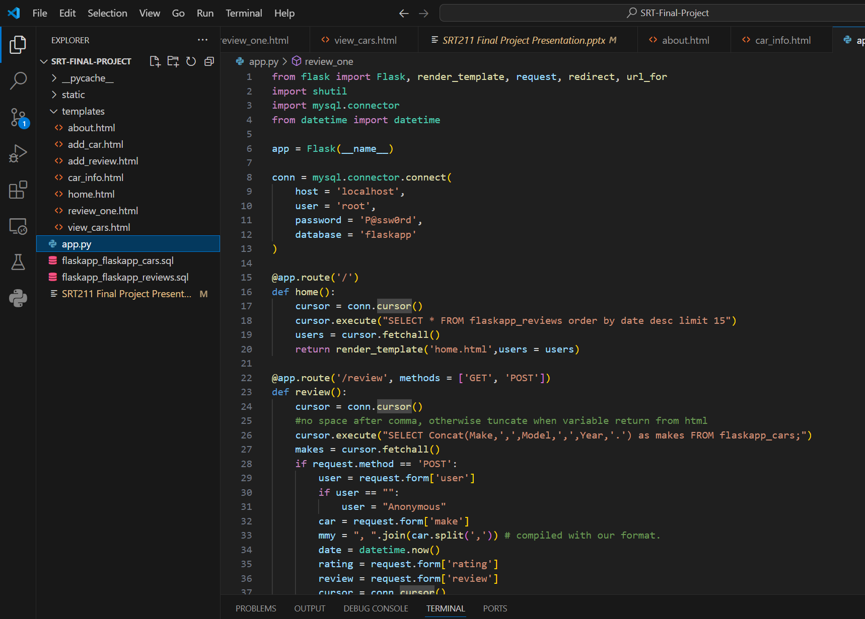
Virtual environment/VSCODE
Virtual environment created for flask app development
app.py – submitted on GitHub
Modules imported: flask, shutil, mysql.connector, datetime
Host, user, password, db information passed to mysql.connector
Handles 9 routes, all GET/POST request from frontend

Slide 9

Project Description
Vehicle Review Web Application
Features:
Allows user to browse directory of vehicles
Allows user to add new vehicles
Allows user to add/view review left for vehicles
Users can leave a review, rating
Users can give like to reviews

Slide 10
Features of Web Application
Navigation Bar
New Vehicle system
Browse system
Review management
Rating and like system
Preference System

Slide 11

Feature #1: Navigation bar
The navigation bar keep tracks of the current page from the site
Can be used to access all main webpages
Home Page
Add a Car Page
View Cars Page
Add a Review Page
About Us Page

Slide 12
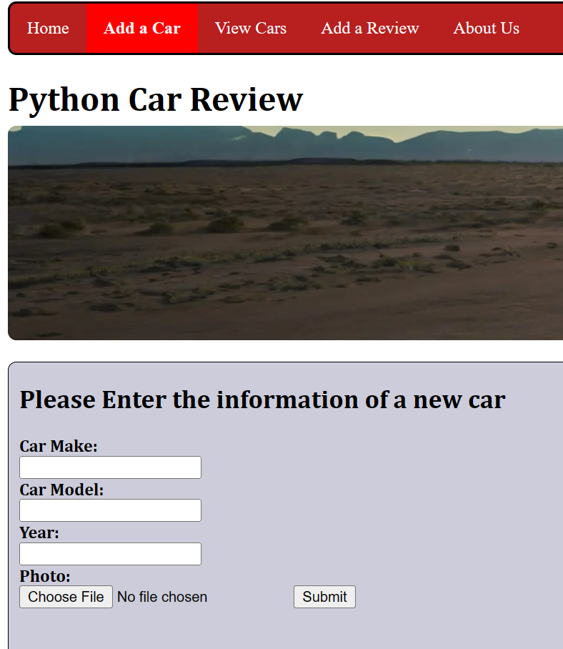
Feature #2: Add System
User can add a new vehicle to the Database
New vehicle will be visible and can be used for reviews by all users
User can specify
Car Make
Car Model
Year
Photo (user uploads photo of vehicle)

Slide 13
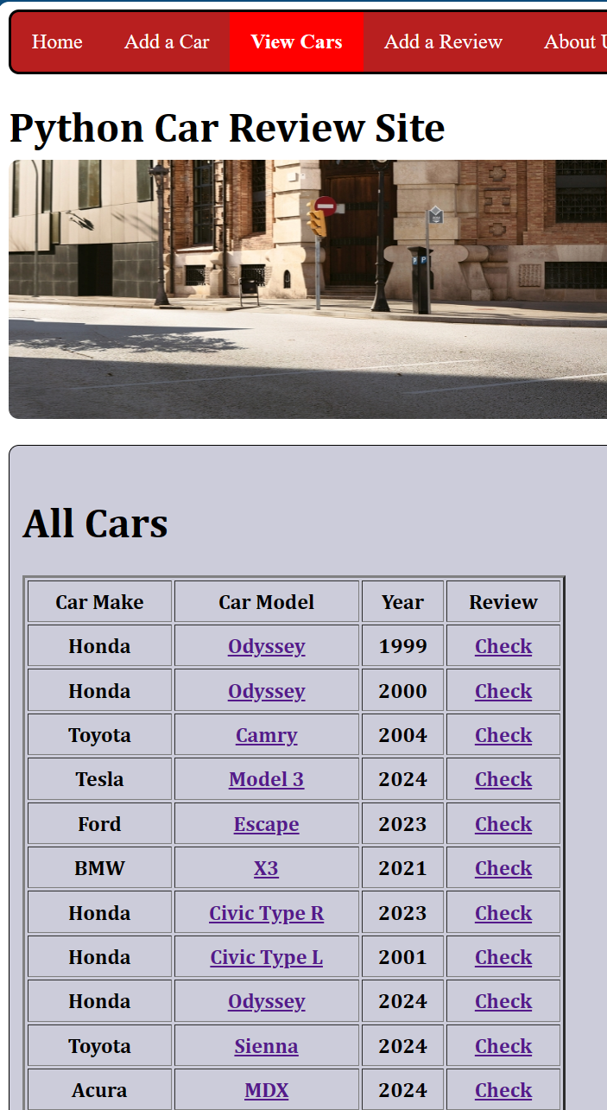
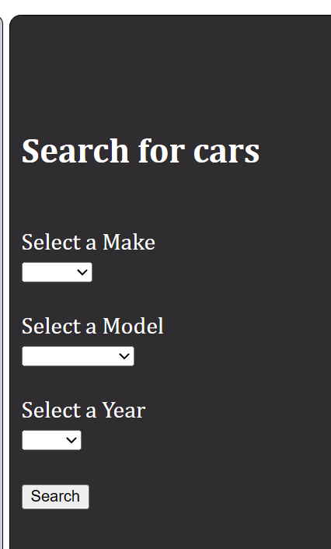
Feature #3: Browse System
Browse system displays library of vehicles saved in the database
Users may click on model to display that vehicle
Users may click on review to display the reviews associated with that vehicle
On the right side, users may search the library of vehicles for something more specific

Slide 14
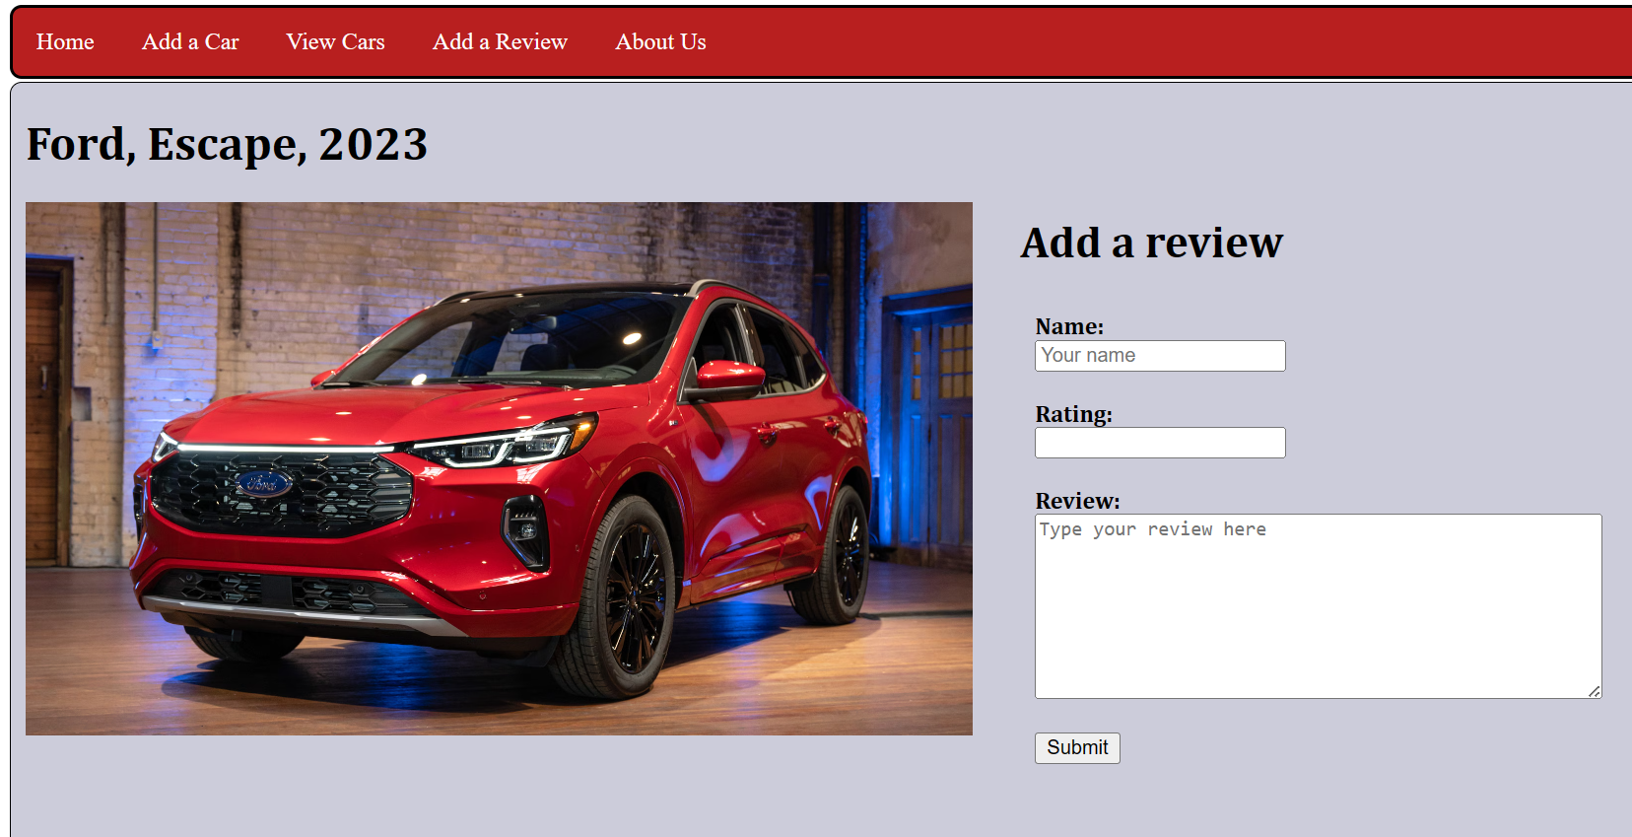
Feature #3: Sub-feature 1: Displays Cars
User will be redirected to a webpage specific for that vehicle
Displays the make, model and year of the vehicle
Displays the photo of the vehicle
Adds the option for users to leave their own review for the vehicle

Slide 15
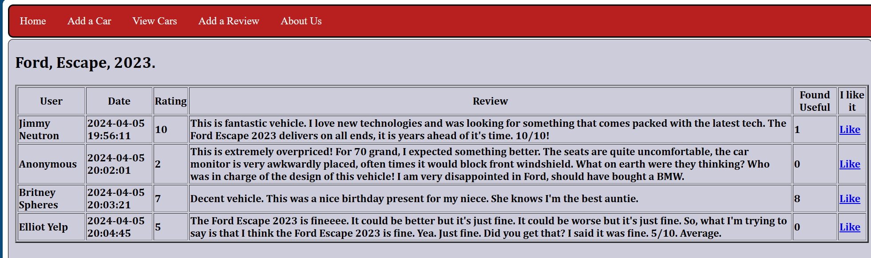
Feature #3: Sub-feature 2: Displays reviews
User will be redirected to a webpage specific for that vehicle
Displays all reviews made for that vehicle

Slide 16
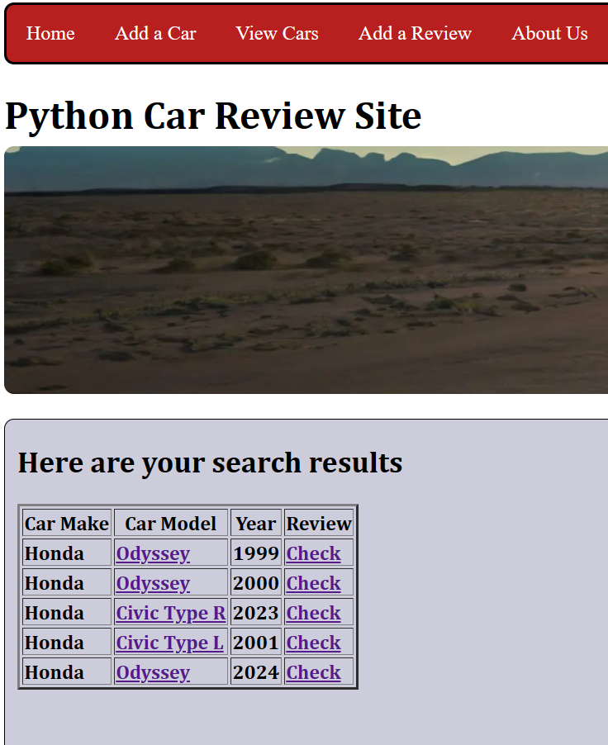
Feature #3: Sub-feature 3: Search Results
User will be redirected to a webpage specific for the search result
Example: will retrieve all “Honda”s after searching for Honda

Slide 17
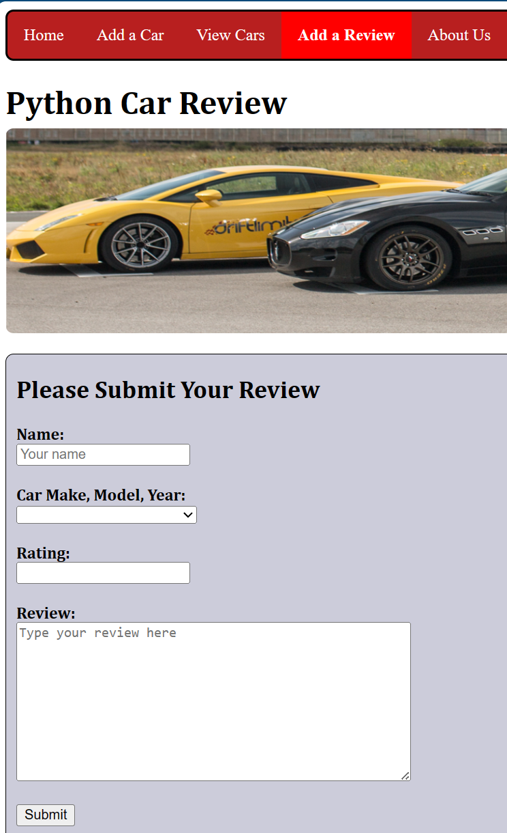
Feature #4: Add Review
The Add a Review page lets the user choose their vehicle and the option for them to submit a review
User must specify
Car Make
Car Model
Year of Manufacture
Rating of 1 to 10 (out of 10)
Review

Slide 18
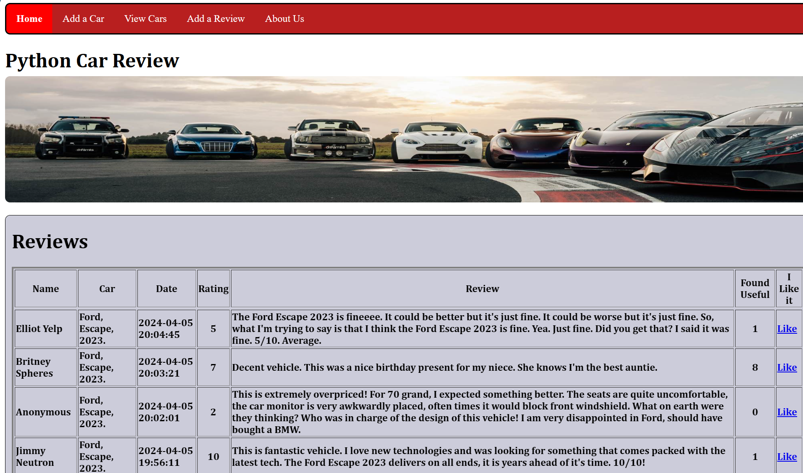
Feature #5: Rating and Like system
The home page lists the most recent reviews from latest to oldest
User can see the ratings left by other users
User can like other reviews: give others the general perception of that review

Slide 19
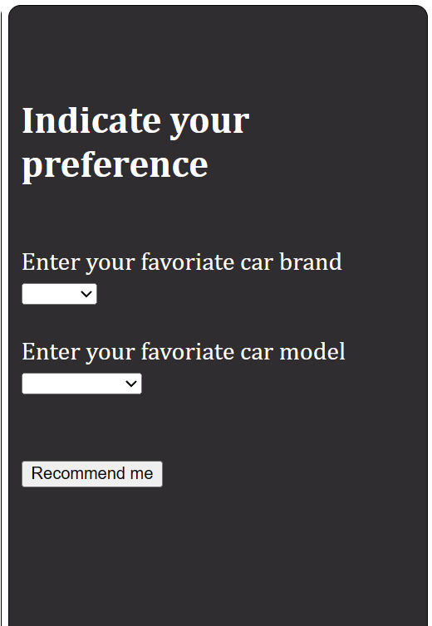
Feature #6: Preference System
The Home page built-in preference system allows user to specify the
Car Make
Car Model
The system will then recommend the user a list of vehicles that matches their preferences

Slide 20
Project Objectives + outcomes
1. Displays a responsive webpage Completed
2. Supports user interaction Completed
3. Stores and retrieves data to/from frontend/backend Completed
4. Involves html, css, python and MySQL
Completed

Slide 21
Thank You
SRT 211 Final Project
Professor Name: Nilay Ganatra
Group 6
Student Names: Yau On Li, David Tang
Student ID: yli693 , dtang31

